Slide 1

ESEM: Automated Systems Analysis using Executable SysML Modeling Patterns
July 18, 2016, Nerijus Jankevičius
No Magic Europe

Slide 2
Outline
Current State of Practice and Need for MBSE
TMT Application
Executable System Engineering Method (ESEM)
Demo video
Summary

Slide 3
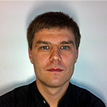


Authors
Nerijus Jankevičius, nerijus@nomagic.com
Product Manager @ No Magic Europe
Leads the development of MBSE tools and solutions since 1997
OMG member, co-author of UML and SysML languages
Robert Karban is a senior systems architect at the Jet Propulsion lab in the Systems Engineering and Formulation Division. Robert works in the domain of Model Based Systems Engineering (MBSE) as the task lead on providing a Model Based Engineering Environment (MBEE) for projects and applies modeling in the Thirty Meter Telescope project.
Maged Elaasar is a senior software architect at the Jet Propulsion Laboratory in the Systems Engineering and Formulation Division.

Slide 4
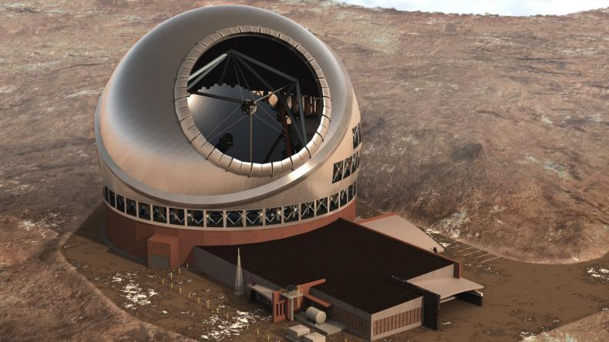
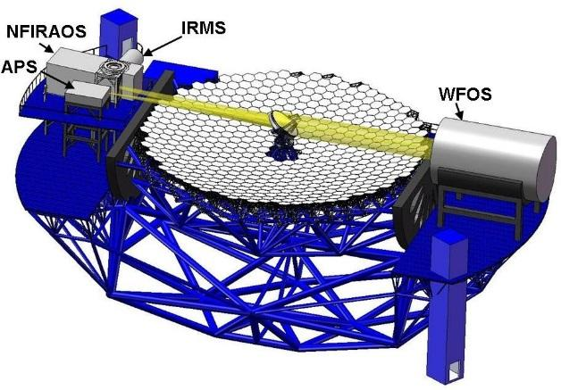
Thirty Meter Telescope (TMT) www.tmt.org
Developed by TMT International Observatory (TIO)
JPL participates in several subsystems of TMT
APS (and AO) team uses MBSE to analyze requirements, produce design, and perform analysis
Alignment and Phasing System (APS)
Sensor responsible for measuring the pre-adaptive optics wavefront quality

Slide 5
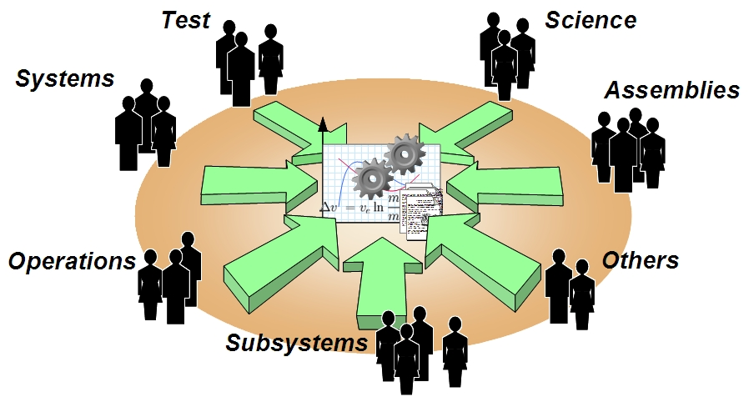
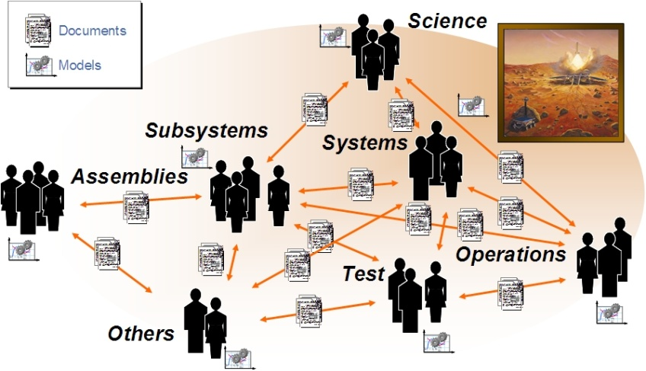
Current Practice to Future Practice
Today: Standalone models related through documents
Future: Shared system model with multiple views, and connected to discipline models
Source : MBSE 101 by Elyse Fosse

Slide 6
Model Based Systems Engineering
MBSE is the formalized application of modeling techniques to support system requirements, design, analysis, verification, validation and documentation activities
MBSE expresses a system using a Systems Modeling Language (SysML), a profile of UML
MBSE is often applied with a method like Object Oriented System Engineering Method (OOSEM)
OOSEM maps onto the ISO systems engineering process and integrates top-down (functional decomposition) approach with model-based approach

Slide 7
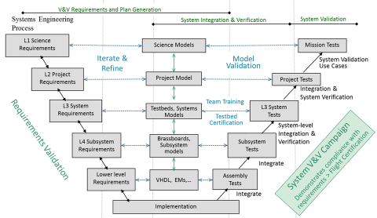
Model-based V-Process at JPL

Slide 8
OpenMBEE https://github.com/Open-MBEE
Provides a platform for modeling that integrates JPL’s mission environment OpenCAE, by incorporating a model repository that can be accessed for example with a rich SysML desktop client (MagicDraw) and a light-weight web-based client (ViewEditor)
The model repository provides the following features:
Basic Infrastructure for Version, Workflow, Access Control
Flexibility of content
Support for Web Applications and Web-based API access
Multi-tool and multi-repository integration across engineering and management disciplines

Slide 9
Systems Analysis
Carry out quantitative assessments of systems in order to select and/or update the most efficient system architecture and to generate derived engineering data.
System analysis provides a rigorous approach to technical decision-making. It is used to perform trade-off studies, and includes modeling and simulation, cost analysis, technical risks analysis, and effectiveness analysis.

Slide 10
Requirements Verification
A kind of systems analysis that assesses whether a system design meets the objectives and satisfies the constraints that are implied by the system requirements

Slide 11
Proposed Approach
Next phase of system modeling emphasizes executable models to enhance understanding , precision, and verification of requirements
Executable Systems Engineering Method (ESEM) augments the OOSEM activities by enabling executable models
ESEM produces executable SysML models that verify requirements
Includes a set of analysis patterns that are specified with various SysML structural, behavioral and parametric diagrams
Also enables integration of supplier/customer models

Slide 12
TMT MBSE Objectives
Use MBSE to define executable SysML model that captures requirements, operational scenarios (use cases), system decomposition, relationships and between subsystems, etc.
Use the model to analyze the system design for
power consumption, mass, and duration
Produce engineering documents
Requirement Flow Down Document
Operational Scenario Document
Design Description Document
Interface Control Documents
Uses standard languages and techniques where practical to avoid custom software development

Slide 13
Typical Analysis Activities Using ESEM
Capture operational use cases with estimated durations of actions, e.g.
Post segment-exchange alignment: requirement: 2h; CBE 1h19m
Capture power and mass characteristics of components
Identify involved subsystems, e.g. Telescope Control System (TCS), M1 Control System (M1CS)
Identify interfaces and interactions among subsystems
Analyze associated scenarios
Automatically verify system requirements are met
Derive requirements for TMT subsystems
Develop/refine timing requirements for algorithms, internal and external interface commands
Notes:
Capture relevant information in a SysML model (system database) using ESEM (Executable Systems Engineering Method)
Used SysML constructs
Block diagrams, State Machines, Activity Diagrams, Sequence diagrams
Simulate system level scenarios
Verify correctness by
Recording traces of simulation in sequence diagrams
Ensure all “leaf” actions have durations constraints applied
Ensure that all actions have been reached in the different scenarios
Automatically verify timing against formal constraints (requirements)
Follow ESEM to define two white box specifications that specialize the black box specification
Conceptual Specification
Realizations Specification
Decompose the white box specifications into elements representing the subsystems

Slide 14
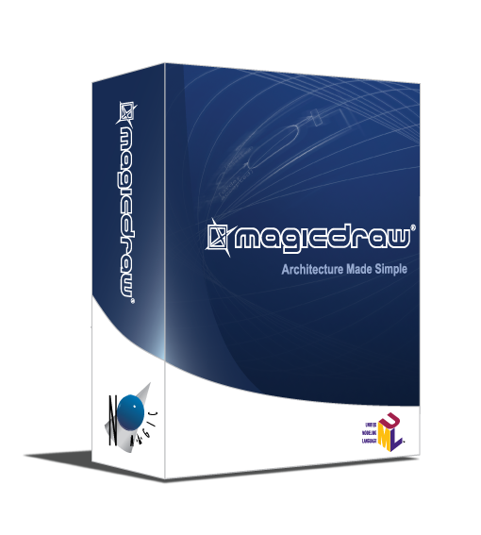
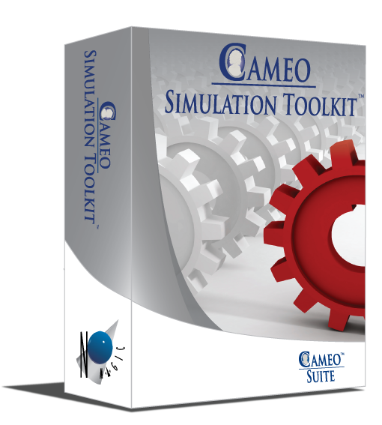



MagicDraw Cameo Simulation Toolkit
Model execution framework and infrastructure:
Model debugging and animation environment
Pluggable engines, languages and evaluators
User Interface prototyping support
Model driven configs and test cases
The standard based model execution of:
Activities (OMG fUML standard)
Composite structures (OMG PSCS)
Statemachines (W3C SCXML standard)
Actions/scripts (JSR223 standard)
Parametrics (OMG SysML standard)
Sequence diagrams (OMG UML Testing Profile)

Slide 15
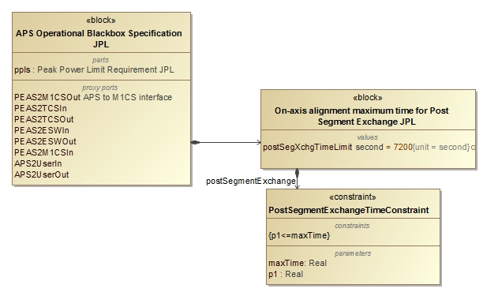
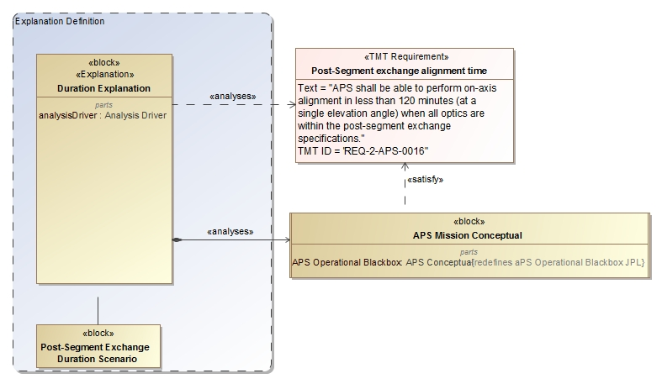
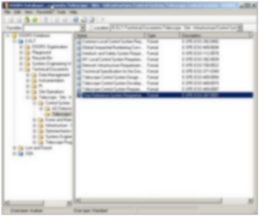
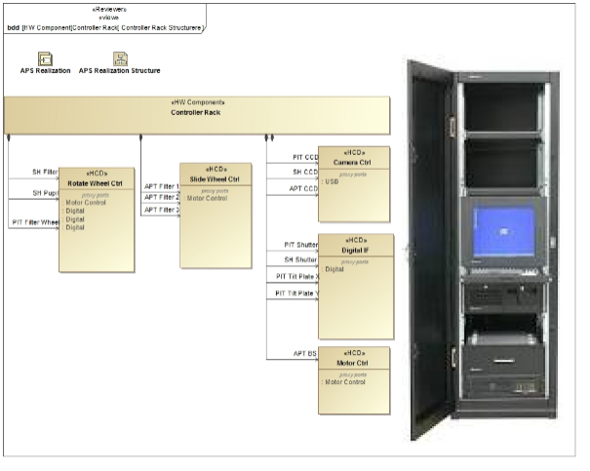
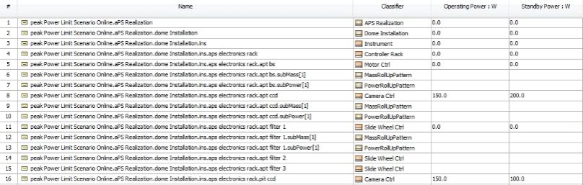
Analysis of Architecture and Design
Update Requirements
Analyze Conceptual Design
2
4
3
Analyze Realization Design/Specification
5
1
Max duration Post-segment exchange: 7200s 5000s
Number of exposures of 45s 4 6
Max peak power consumption in dome: 8.5kw 8.1kw Number of motors with 50W 10 12
6
Pass/fail
OCD, Requirements, ICD, DDD
Notes:
Touches on all modeling capabilities: construction, visualization, analysis, management, exchange and integration, collaboration and workflow

Slide 16
Executable System Engineering Method (ESEM)
Step 1: Formalize Requirements
Step 2: Specify Design
Step 3: Characterize Components
Step 4: Specify Analysis Context
Step 5: Specify Operational Scenarios
Step 6: Specify Analysis Configurations
Step 7: Run Analysis

Slide 17
Step 1: Formalize Requirements
Requirement Pattern
Customer Side
Define the textual requirement with a Requirement
Optionally define a design black box specification with a Block with relevant value properties
Optionally refine the Requirement with a Constraint Block on the black box design Block
Supplier Side
Define a design black box specification with a Block (that refines the customer’s black box Block if any and provides tighter property values)
Refine the textual Requirement by a Constraint Block (if not already defined by the customer)

Slide 18
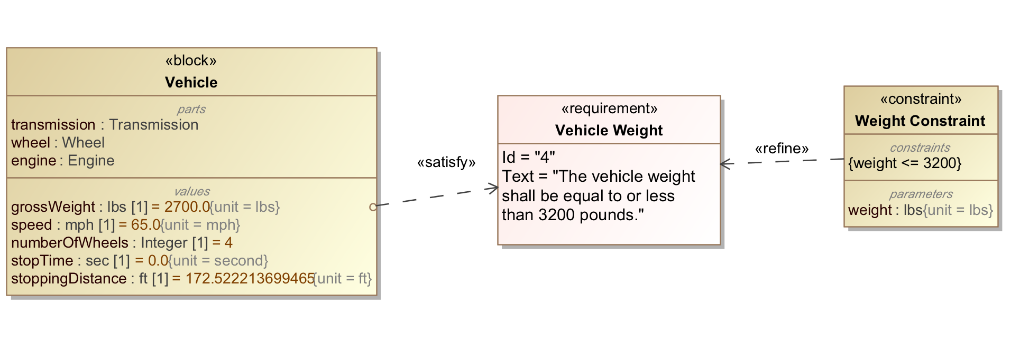
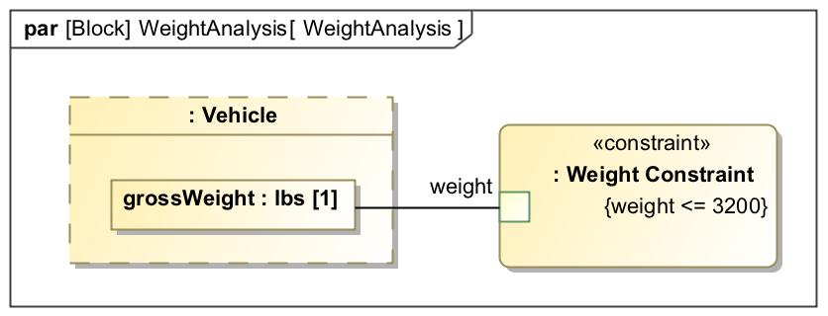
Satisfy, refine, bind

Slide 19
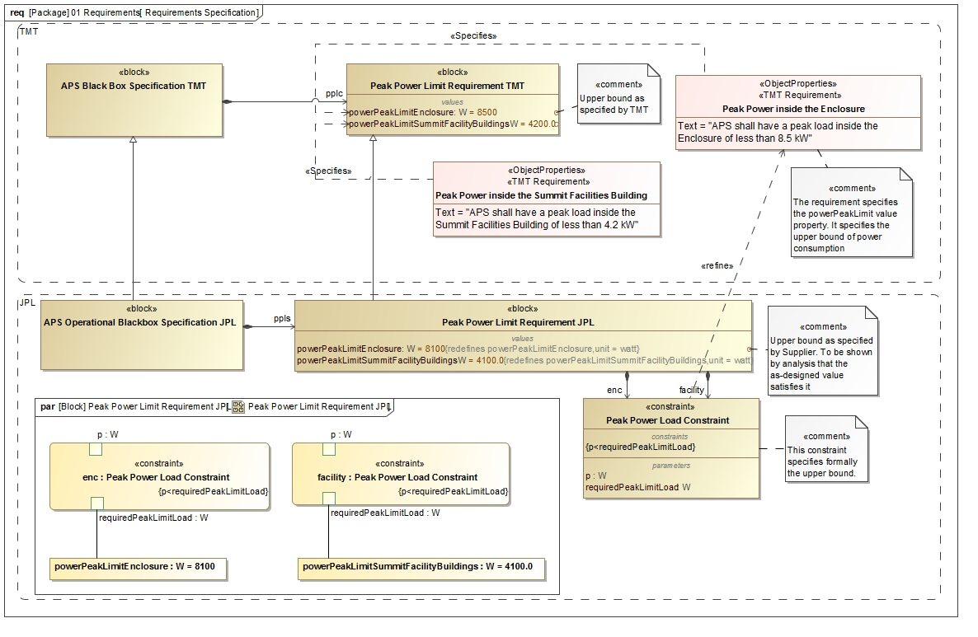
Step 1: Formalize Requirements

Slide 20
Step 2: Specify Design
Follow OOSEM to define two white box specifications that specialize the black box specification
Conceptual Specification
Realization Specification
Decompose the white box designs into Blocks representing the subsystems

Slide 21
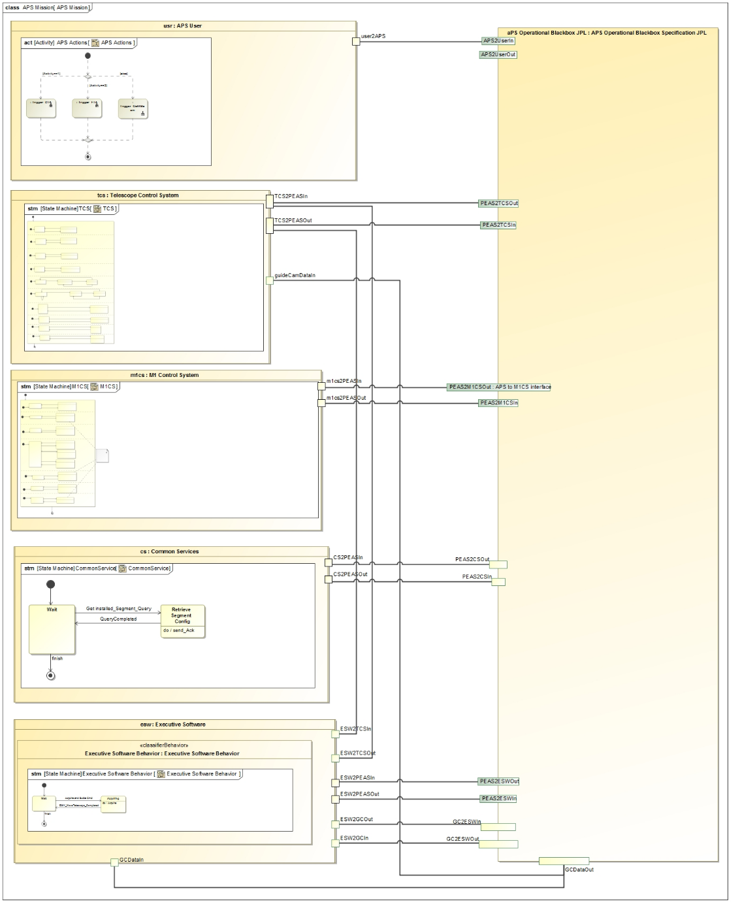
Black Box Level
Operator
Project level components communicate with APS black box block
TCS
APS Black Box
M1CS
CS
ESW

Slide 22
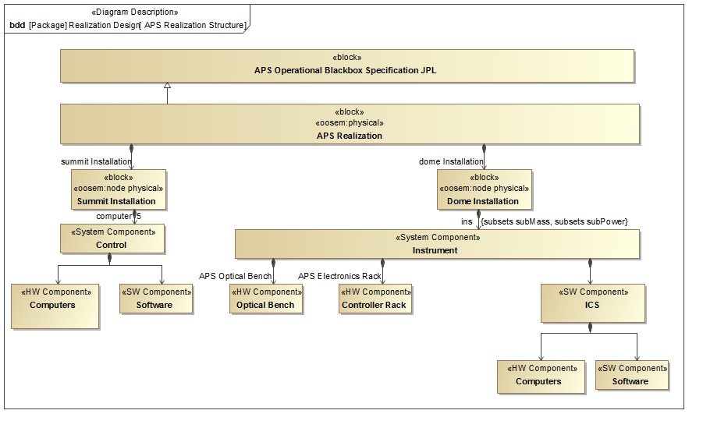
Step 2: Realization
System Decomposition Hierarchy

Slide 23
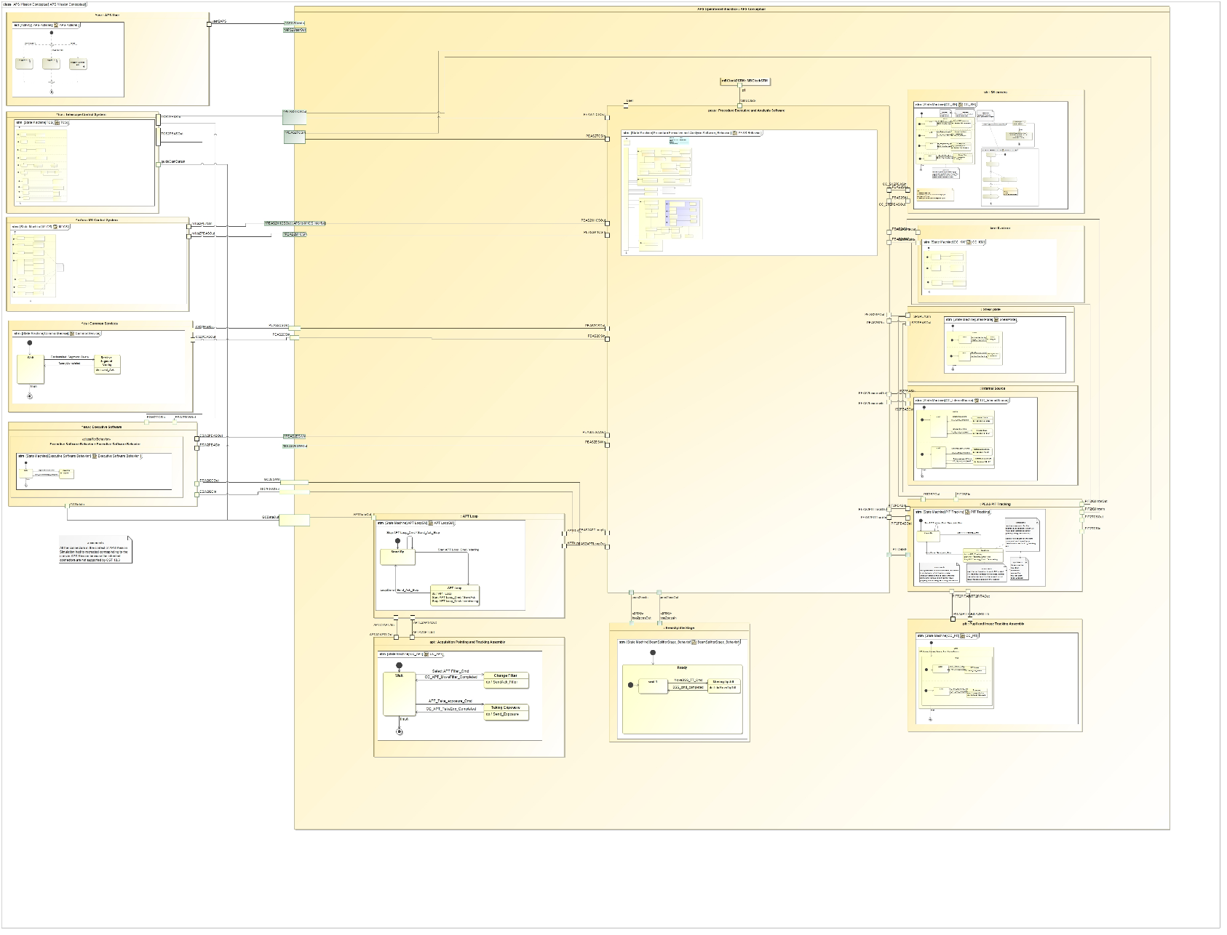
Step 2: Conceptual Model
SH
PEAS
M1CS
Communication between state machine specified components over ports

Slide 24
Step 3: Characterize Components
Add relevant patterns to the design Block to make it executable
Example: Roll-up Pattern
Constrained value represents an aggregate value that is propagating up a hierarchy of subcomponents
Static roll-up (e.g., mass roll-up)
Dynamic roll-up (e.g., power roll-up)

Slide 25
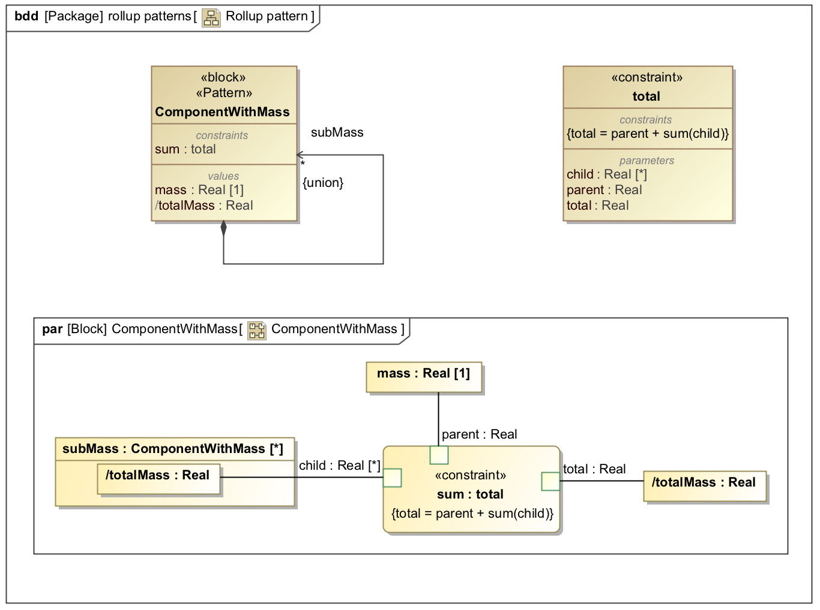
Parametric Rollup Pattern

Slide 26
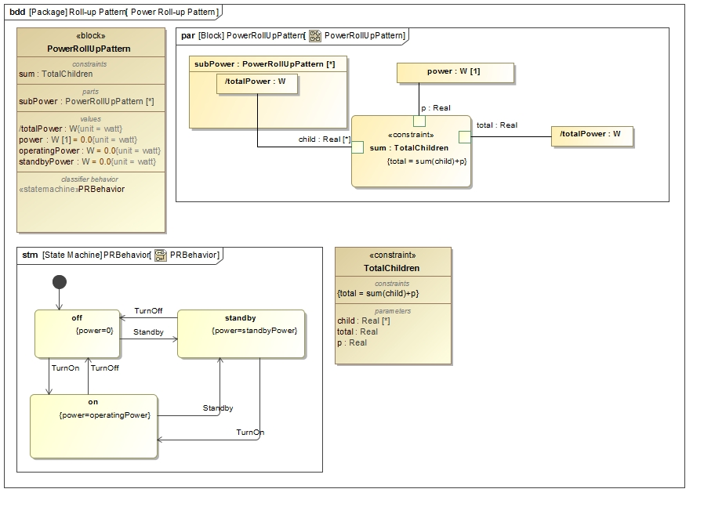
Step 3: Characterize Components
State constraints
Power Rollup Pattern

Slide 27
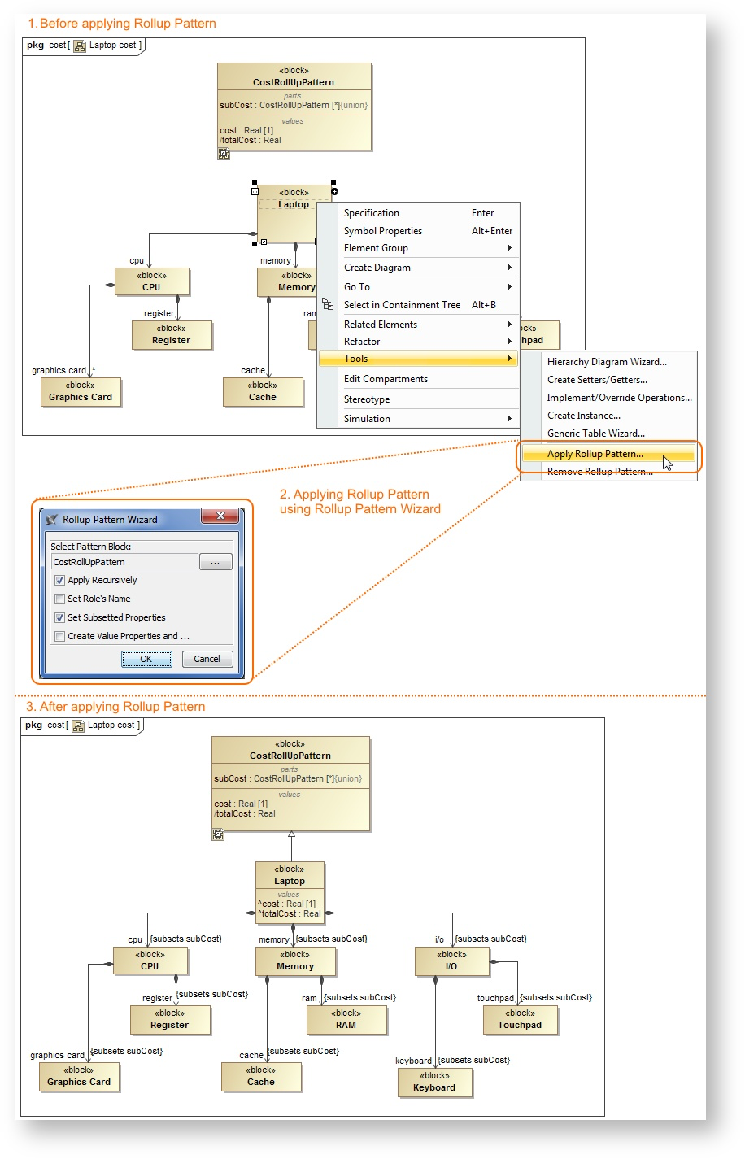
Automation

Slide 28
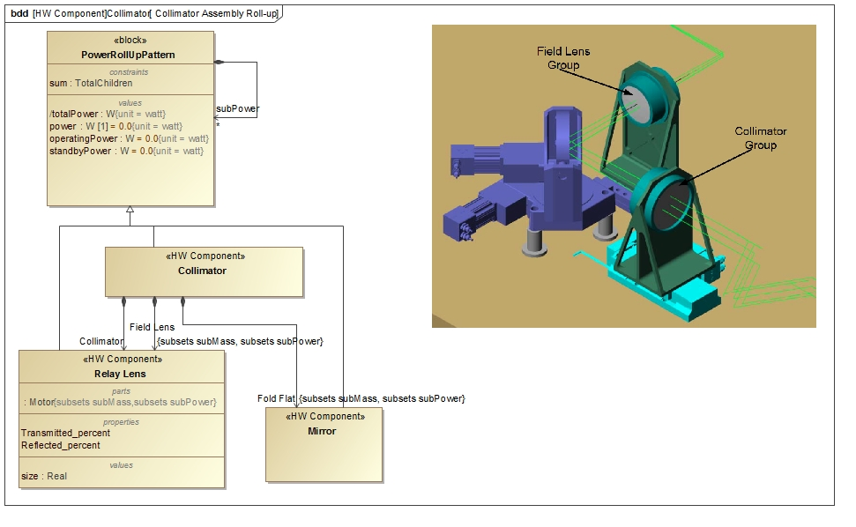
Step 3: Characterize Components
Power Roll-up Pattern Application

Slide 29
Step 4: Specify Analysis Context
Analysis Context Pattern
Abstract analysis context Block composes both the design black box Block and white box Block
Analysis properties defined on the analysis context Block (e.g., peak power, power margin)
Analysis parametric model on the analysis context that computes and binds analysis values

Slide 30
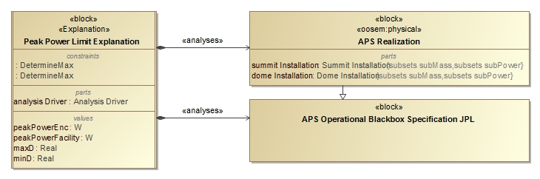
Step 4: Specify Analysis Context
Analysis Context Pattern

Slide 31
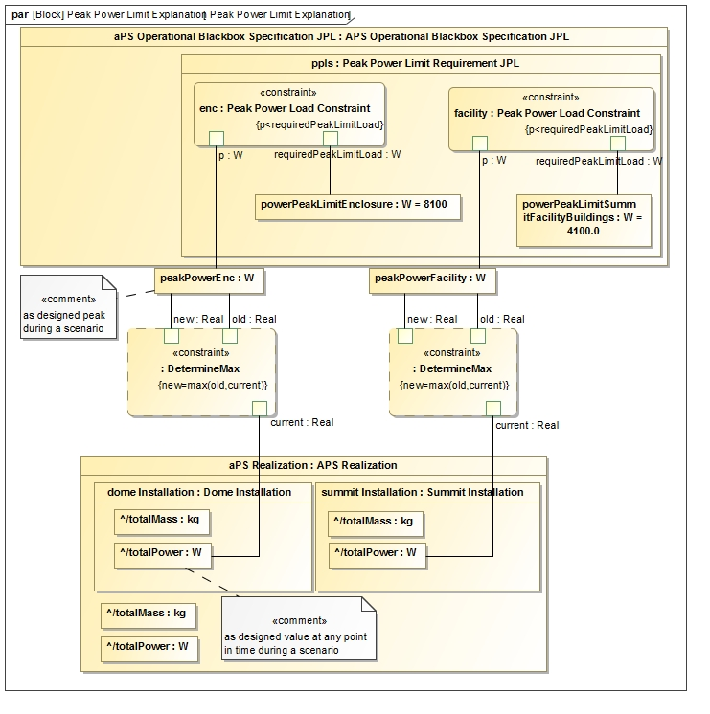
Step 4: Specify Analysis Context
Analysis Context Parametric Model

Slide 32
Step 5: Specify Operational Scenarios
Operational Scenario Pattern
Concrete analysis context Block that
Represents one operational scenario (e.g., power configuration)
Specializes the abstract analysis context Block
Redefines context’s properties with scenario-specific values
Defines an owned behavior (sequence diagram) as scenario driver
Changes the states of the different components, by sending them signals, causing the rolling-up to occur automatically
Can specify duration constraints to time the injection of signals thus controlling time spent in a certain state
Can use state constraints (on components) to verify during execution if a component is actually in expected state

Slide 33
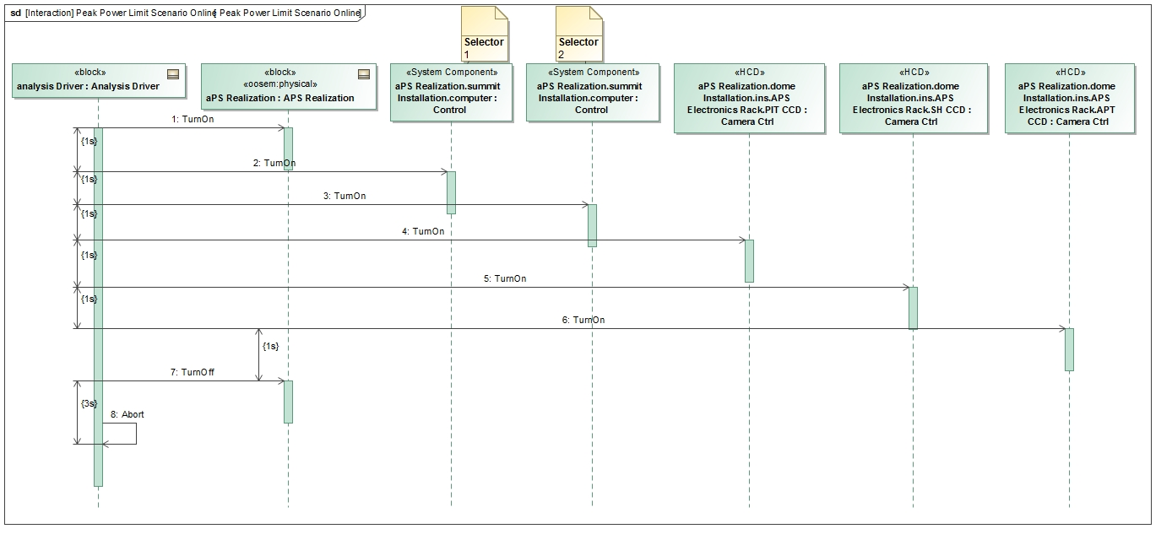
Step 5: Specify Operational Scenarios
Operational Scenario Driver

Slide 34
Step 2: Conceptual Model
SH
PEAS
M1CS
Communication between state machine specified components over ports

Slide 35
Step 6: Specify Scenario Configurations
Scenario Condition Pattern
A decomposition tree of instance specifications representing the state of the scenario
Can be presented in tabular form
Rows represent the instance specifications (e.g., component)
Columns represent values (e.g., operating power) from the instance specifications
Issues
Hard to keep instance specifications in sync with Block hierarchy
Mitigation: tool automation
Instance specifications cannot be displayed in IBDs
Mitigation: use full specialization tree of singleton Blocks for each scenario

Slide 36
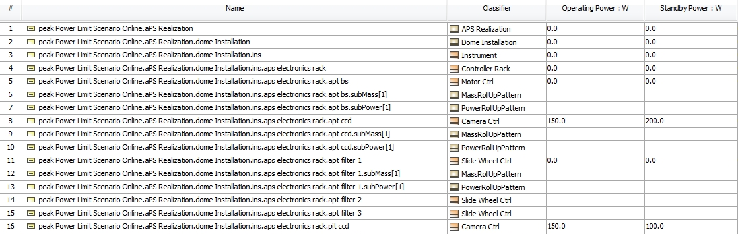
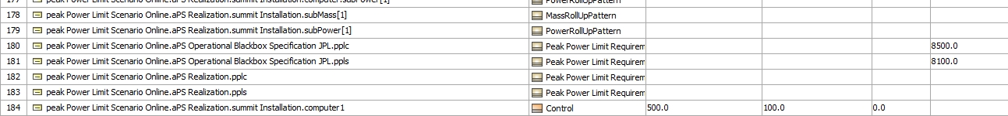
Step 6: Specify Analysis Configurations
Scenario Initial Condition Pattern

Slide 37
Step 7: Run Analysis
Run the configured analysis with a simulation engine on the initial conditions to get the final conditions:
Produce the following views on final conditions
Table showing final analysis values (e.g., peak power) and the constraint’s pass/fail status for each scenario
Timelines: state changes for components over time
Value profiles: total rolled up values over time

Slide 38
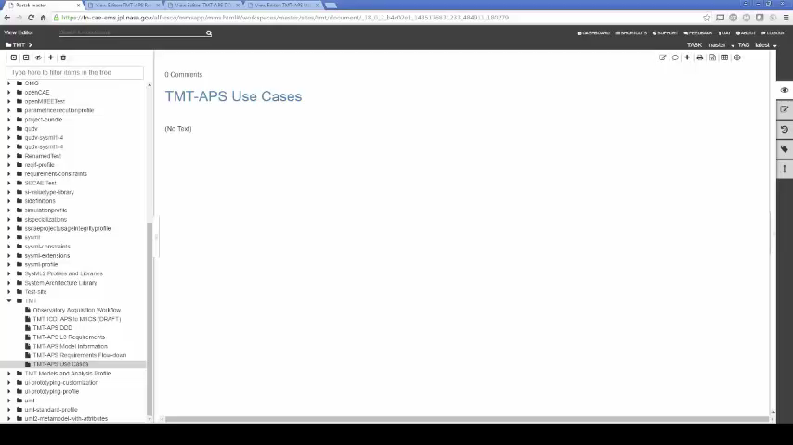
System Level Analysis

Slide 39
TMT Model
Customer and supplier model in same SysML project, APS and Adaptive Optics
Project level (customer) conceptual elements re-used for simulation in downstream design
Analysis: Duration, Power and Mass
https://github.com/Open-MBEE/TMT-SysML-Model

Slide 40
Summary & Outlook
It is possible to automate requirements verification in SysML models
Introduced a new Executable System Engineering Method that consists of a set of pure SysML analysis patterns
The method can be executed using an Off the shelf simulation engine for SysML
big interest in other projects at JPL
Trigger Analysis from Web interface and auto-generate documents
Integrate analysis engine (solver)
Integrate FMI units

Slide 41
Thank You ! Visit No Magic booth at H1-H2

Slide 42
Acknowledgments
The research was carried out at the Jet Propulsion Laboratory, California Institute of Technology, under a contract with the National Aeronautics and Space Administration and No Magic Inc.
The TMT Project gratefully acknowledges the support of the TMT collaborating institutions. They are the Association of Canadian Universities for Research in Astronomy (ACURA), the California Institute of Technology, the University of California, the National Astronomical Observatory of Japan, the National Astronomical Observatories of China and their consortium partners, and the Department of Science and Technology of India and their supported institutes. This work was supported as well by the Gordon and Betty Moore Foundation, the Canada Foundation for Innovation, the Ontario Ministry of Research and Innovation, the National Research Council of Canada, the Natural Sciences and Engineering Research Council of Canada, the British Columbia Knowledge Development Fund, the Association of Universities for Research in Astronomy (AURA) and the U.S. National Science Foundation.

Slide 43
Reference
Karban, R., Jankevičius, N., Elaasar, M. “ESEM: Automated Systems Analysis using Executable SysML Modeling Patterns”, (to appear in the proceedings of INCOSE International Symposium (IS), Edinburgh, Scotland, 2016.)
Karban, R., “Using Executable SysML Models to Generate Systems Engineering Products”, NoMagic World Symposium, Allen, TX, 2016
Open Source TMT model: https://github.com/Open-MBEE/TMT-SysML-Model
Open Source Engineering Environment: https://github.com/Open-MBEE
A Practical Guide to SysML, 3rd Edition, Chapter 17 by Friedenthal, Moore, and Steiner
Zwemer, D., “Connecting SysML with PLM/ALM, CAD, Simulation, Requirements, and Project Management Tools”, May 2016

Slide 44
Backup

Slide 45
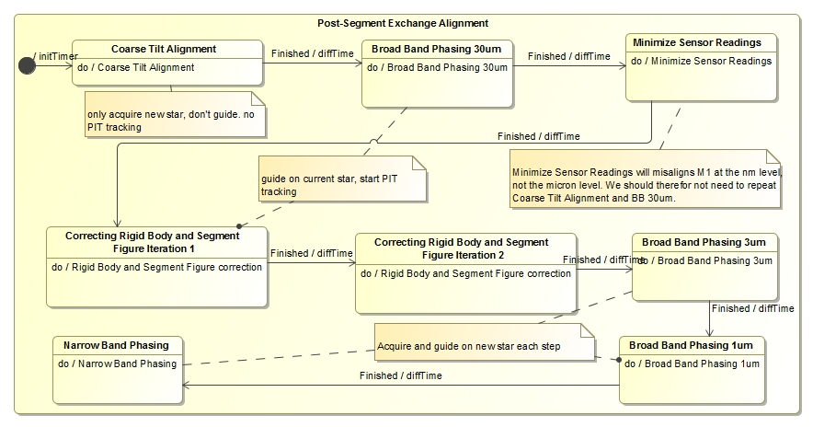
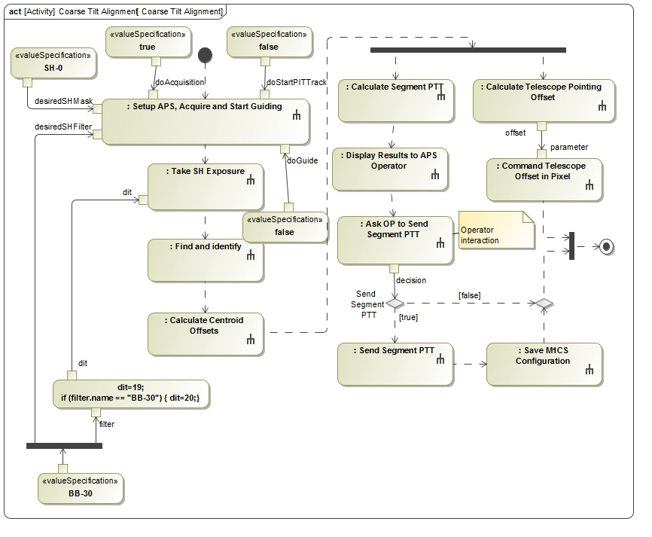
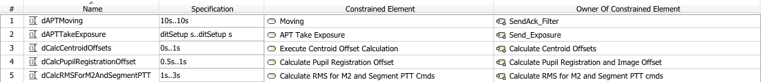
Conceptual Design
1
Operational behavior captured with
state machines and activity models
2

Slide 46
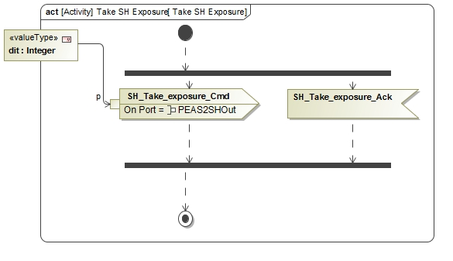
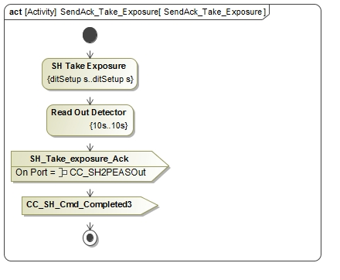
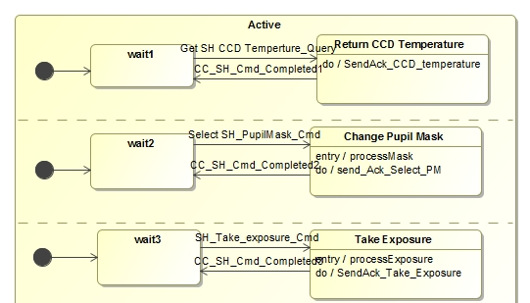
Conceptual behavior model
3
Dynamic and fixed duration constraints
1
Communicating
state machines
2
Duration analysis results verified against requirement for a particular configuration
4

Slide 47
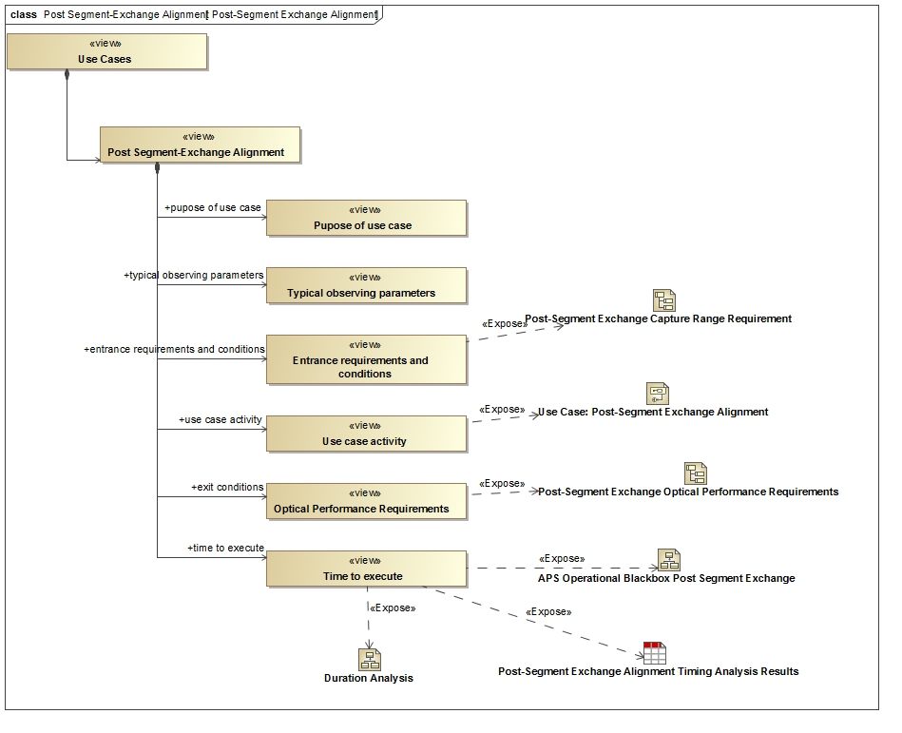
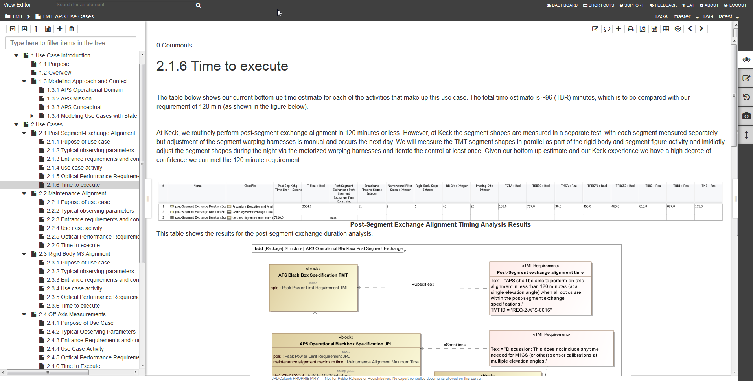
OpenMBEE Core Integration
Model of Document in
MagicDraw/Model Development Kit
MMS repository
Rendered and editable document in Web interface View Editor

